Slide 1
Verification of rlgc2s() Function in Matlab
Davit Kharshiladze
Yifan Ding
Chulsoon Hwang

Slide 2
Table of Contents
RLGC Matrixes
rlgc2s() Function Overview
Verification of the Function by Simple Transmission Line Simulation
Verification of the Function by Differential Pair of Stripline
Verification of the Function by IMLC Simulations

Slide 3
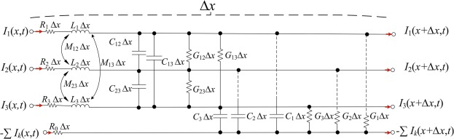
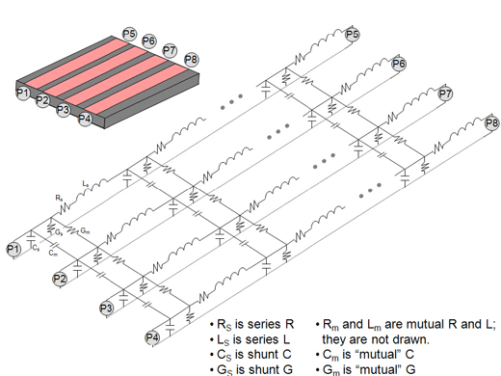
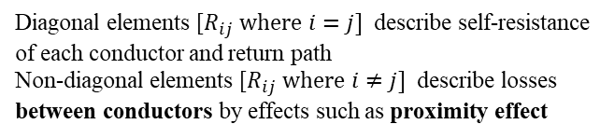
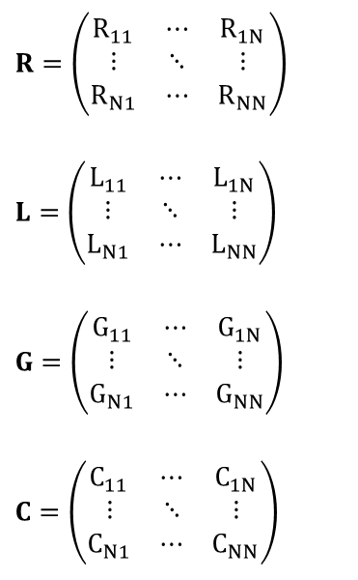
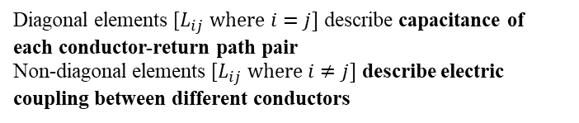
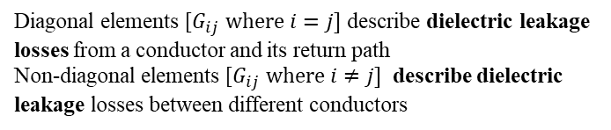
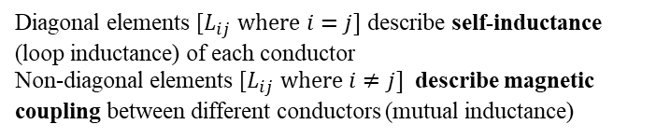
RLGC Matrices
RLGC matrices fully describe behavior of transmission line groups. Giving large amounts of information, other important characteristics of the system can be derived from them.
$$R=\left(\begin{matrix}R_{11} & ⋯ & R_{1N} \\ ⋮ & ⋱ & ⋮ \\ R_{N1} & ⋯ & R_{NN}\end{matrix}\right)$$
$$L=\left(\begin{matrix}L_{11} & ⋯ & L_{1N} \\ ⋮ & ⋱ & ⋮ \\ L_{N1} & ⋯ & L_{NN}\end{matrix}\right)$$
$$G=\left(\begin{matrix}G_{11} & ⋯ & G_{1N} \\ ⋮ & ⋱ & ⋮ \\ G_{N1} & ⋯ & G_{NN}\end{matrix}\right)$$
$$C=\left(\begin{matrix}C_{11} & ⋯ & C_{1N} \\ ⋮ & ⋱ & ⋮ \\ C_{N1} & ⋯ & C_{NN}\end{matrix}\right)$$
Diagonal elements [$R_{ij} where i=j]$ describe self-resistance of each conductor and return path
Non-diagonal elements [$R_{ij} where i≠j]$ describe losses between conductors by effects such as proximity effect
Diagonal elements [$L_{ij} where i=j]$ describe self-inductance (loop inductance) of each conductor
Non-diagonal elements [$L_{ij} where i≠j]$ describe magnetic coupling between different conductors (mutual inductance)
Diagonal elements [$G_{ij} where i=j]$ describe dielectric leakage losses from a conductor and its return path
Non-diagonal elements [$G_{ij} where i≠j]$ describe dielectric leakage losses between different conductors
Diagonal elements [$L_{ij} where i=j]$ describe capacitance of each conductor-return path pair
Non-diagonal elements [$L_{ij} where i≠j]$ describe electric coupling between different conductors
In each matrix, conjugate indexed values are the same i.e. ${A_{ij}=A}_{ji}$

Slide 4

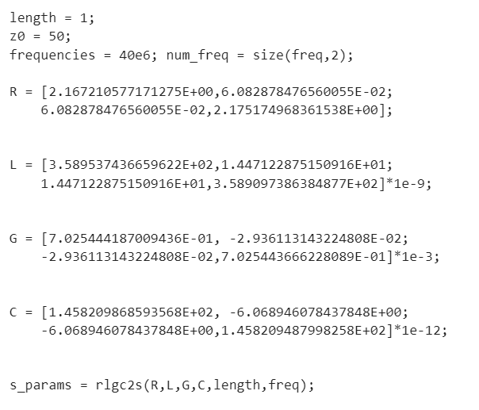

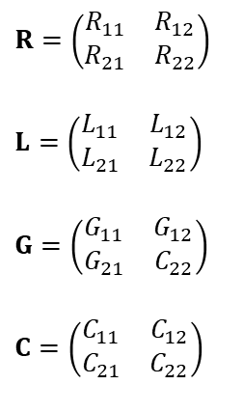






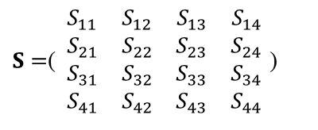

rlgc2s() Function in Matlab
rlgc2s() function allows conversion between distributed parameters to s-parameters of the system
$$P_{2}$$
Length of the transmission line
Example Snippet
$$P_{1}$$
$$P_{3}$$
$$P_{4}$$
*order of ports are changed
$$P_{1}$$
$$P_{3}$$
$$R=\left(\begin{matrix}R_{11} & R_{12} \\ R_{21} & R_{22}\end{matrix}\right)$$
$$L=\left(\begin{matrix}L_{11} & L_{12} \\ L_{21} & L_{22}\end{matrix}\right)$$
$$G=\left(\begin{matrix}G_{11} & G_{12} \\ G_{21} & C_{22}\end{matrix}\right)$$
$$C=\left(\begin{matrix}C_{11} & C_{12} \\ C_{21} & C_{22}\end{matrix}\right)$$
$$P_{2}$$
$$P_{4}$$
$S=$( $\begin{matrix}S_{11} & S_{12} & S_{13} & S_{14} \\ S_{21} & S_{22} & S_{23} & S_{24} \\ S_{31} & S_{32} & S_{33} & S_{34} \\ S_{41} & S_{42} & S_{43} & S_{44}\end{matrix}$ )
Per meter
distributed parameters
S parameters are in Real Imaginary format
R,L,G,C matrices can be 3 dimensional (NxNxM) where M is number of frequency points. This allows frequency dependent RLGC parameter conversion
For detailed information see this URL

Slide 5
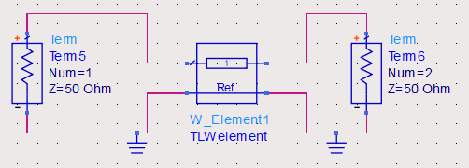
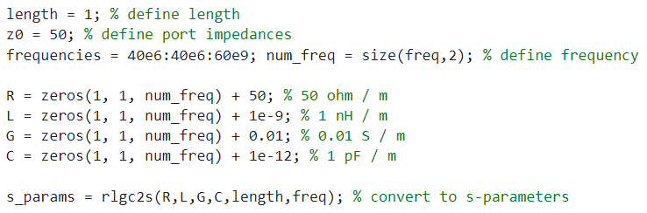
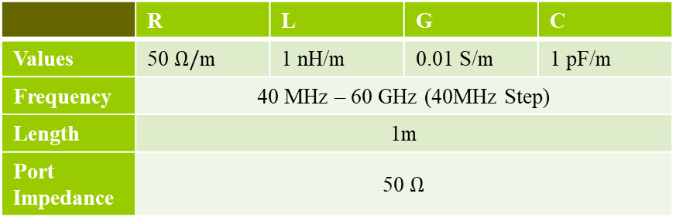
Verification of the Function by Simple Transmission Line Simulation
To verify rlgc2s() function, series of tests were conducted. Simplest test was created using a single transmission line and two ports
Simulate simple circuit: Two-Ports connected by TL with frequency-independent RLGC parameters
Obtain S parameters from circuit simulator (In this case keysight ADS)
Create matlab script which converts same RLGC parameters to S parameters using rlgc2s()
Compare Obtained S parameters
 | R | L | G | C
Values | 50 $Ω/$m | 1 nH/m | 0.01 S/m | 1 pF/m
Frequency | 40 MHz – 60 GHz (40MHz Step)
Length | 1m
Port Impedance | 50 $Ω$
Simple Matlab Script
Simple Model in Keysight ADS
Input Port
Transmission Line (W-Element in ADS)
Output Port

Slide 6
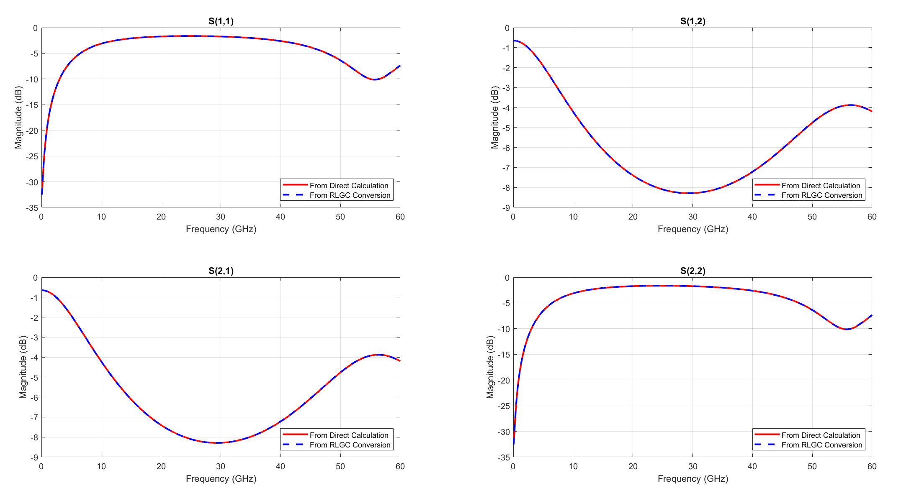
Verification of the Function by Simple Transmission Line Simulation - Results

Slide 7
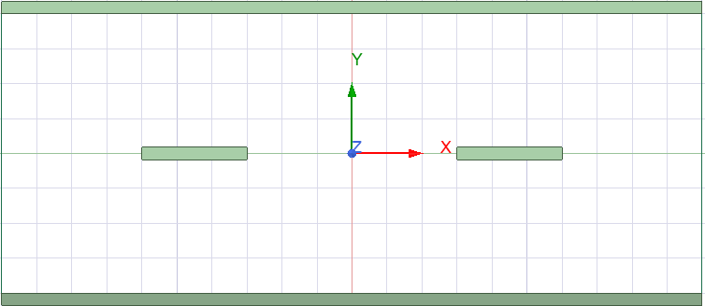
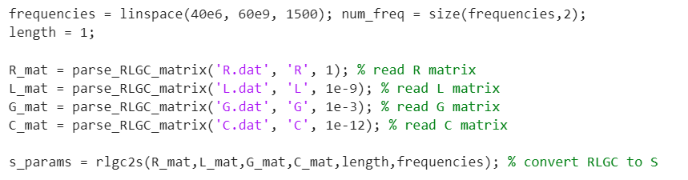

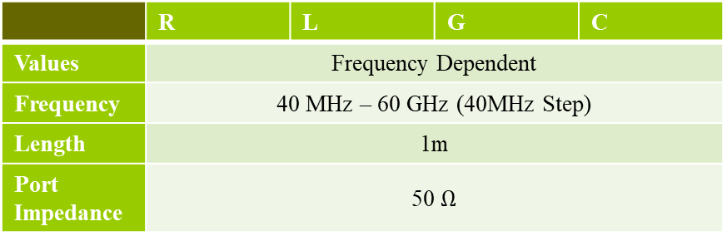

Verification of the Function by Differential Pair of Stripline
Second step in verifying was to use it in more complicated case. This time, RLGC parameters would be frequency-dependent
Create a differential pair of stripline in Ansys Q2D
Obtain distributed RLGC values for this configuration and S parameters
Feed RLGC values to rlgc2s() function to obtain S parameters using Matlab
Compare S parameters obtained from Matlab to S parameters obtained from Ansys Q2D
 | R | L | G | C
Values | Frequency Dependent
Frequency | 40 MHz – 60 GHz (40MHz Step)
Length | 1m
Port Impedance | 50 $Ω$
Q2D Model
4mm
Matlab Script
FR-4 Substrate
1.6mm
Ground
0.6mm
70 $μ$m
Ground
Positive Pair
Negative Pair
70 $μ$m

Slide 8
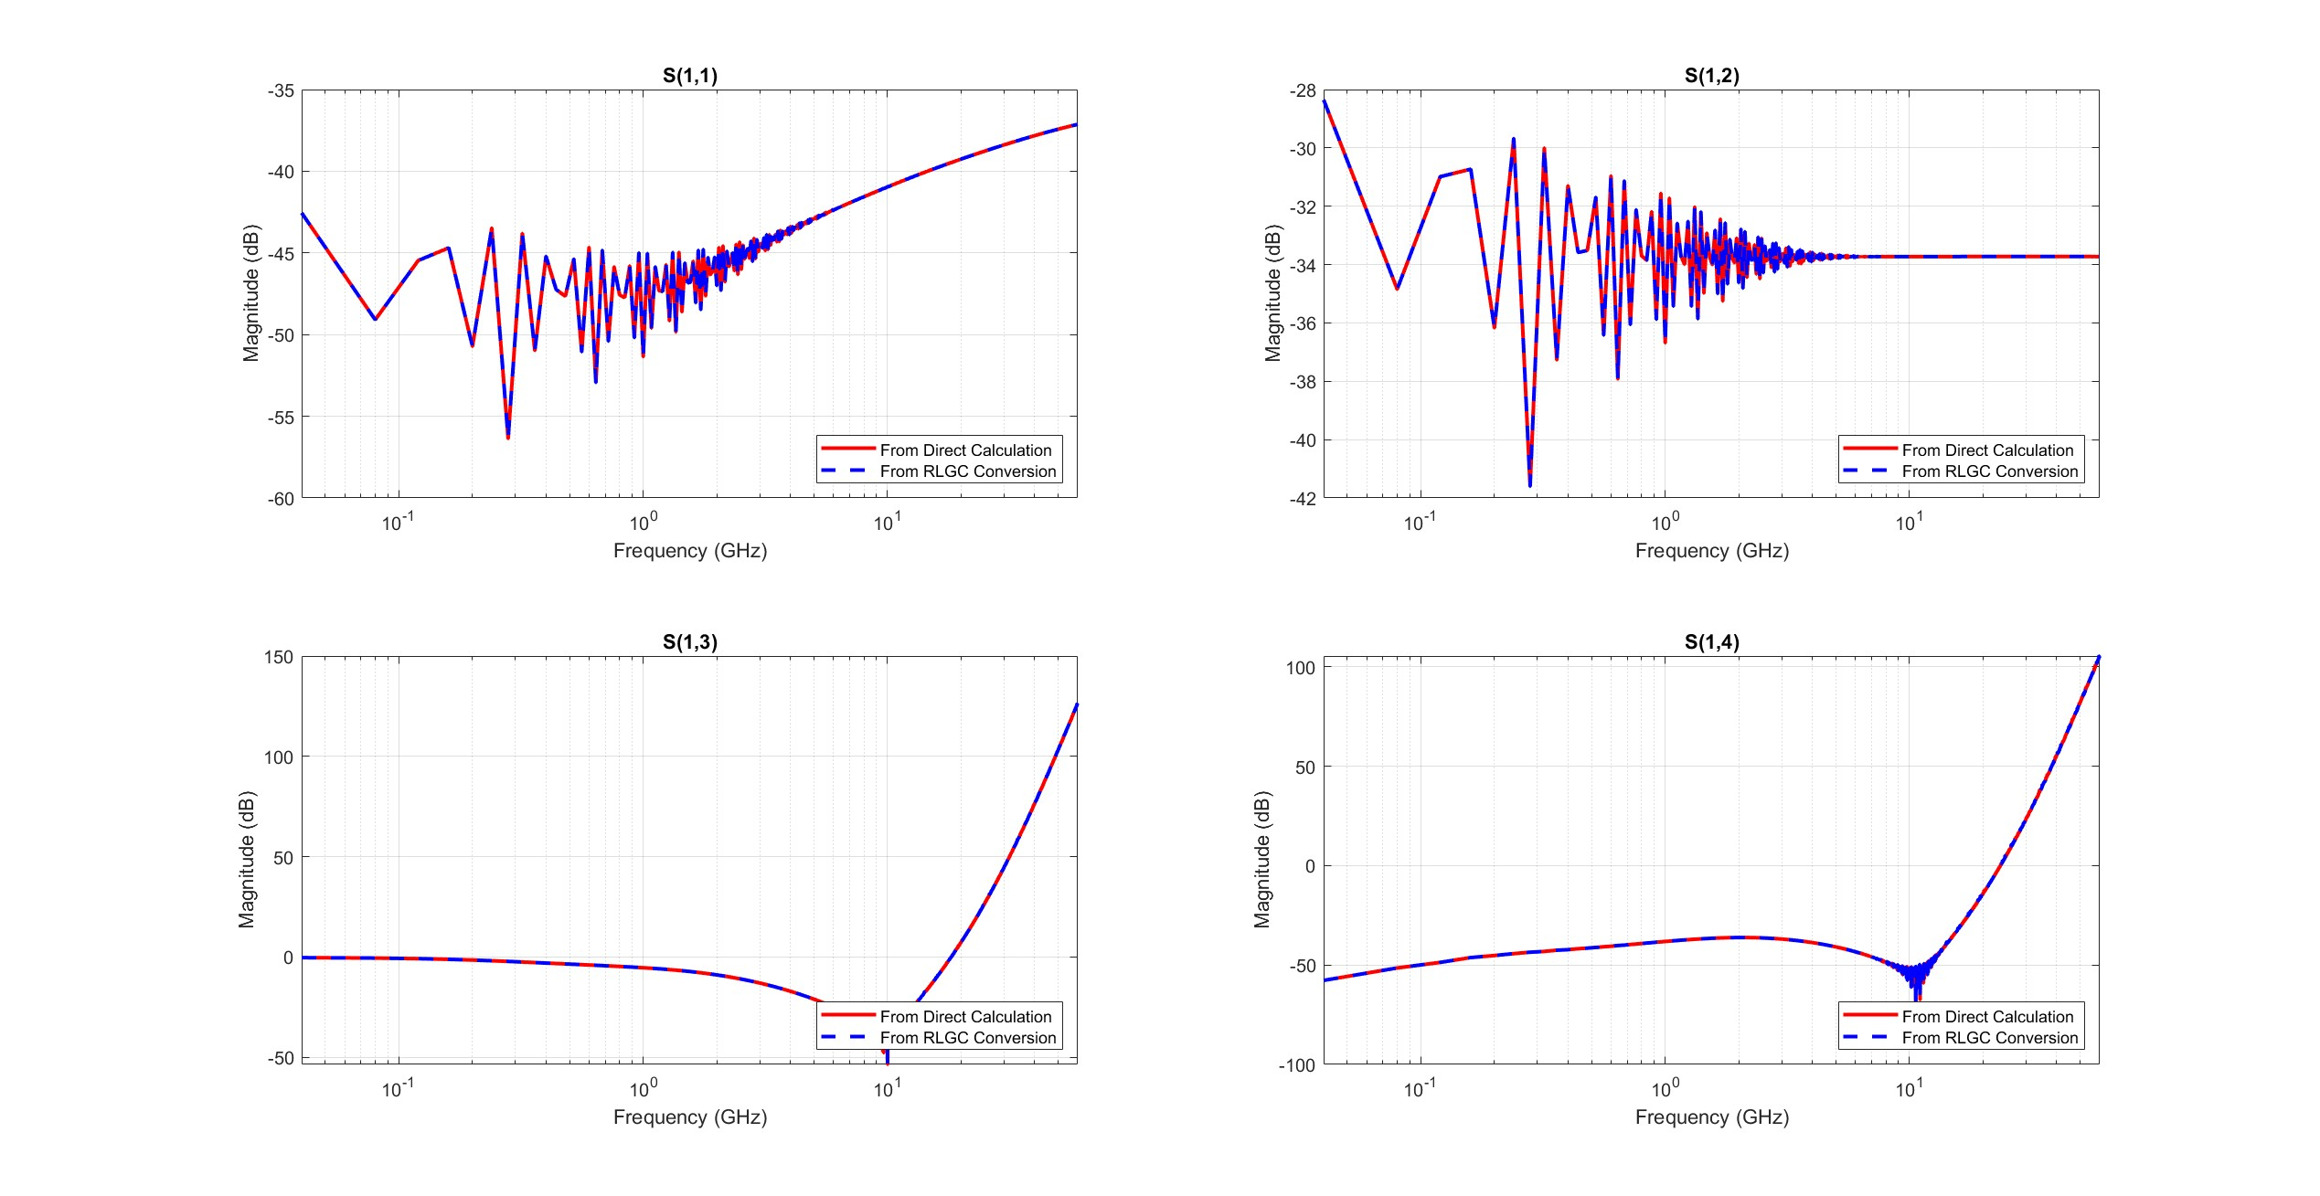
Verification of the Function by Differential Pair of Stripline - Results

Slide 9
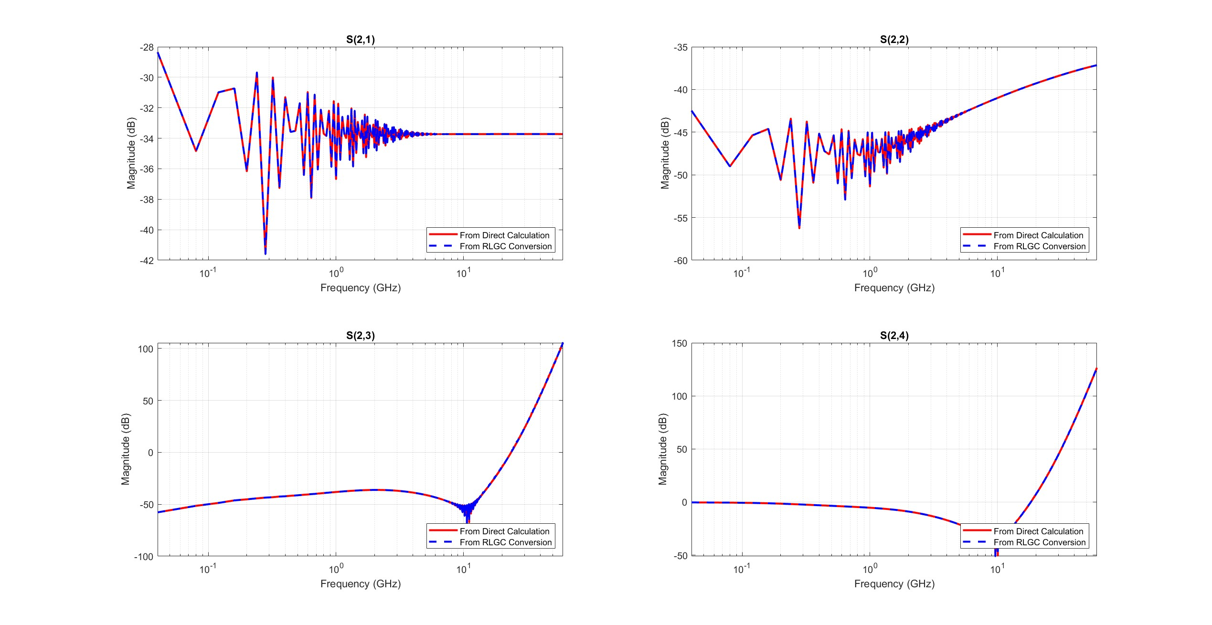
Verification of the Function by Differential Pair of Stripline - Results

Slide 10
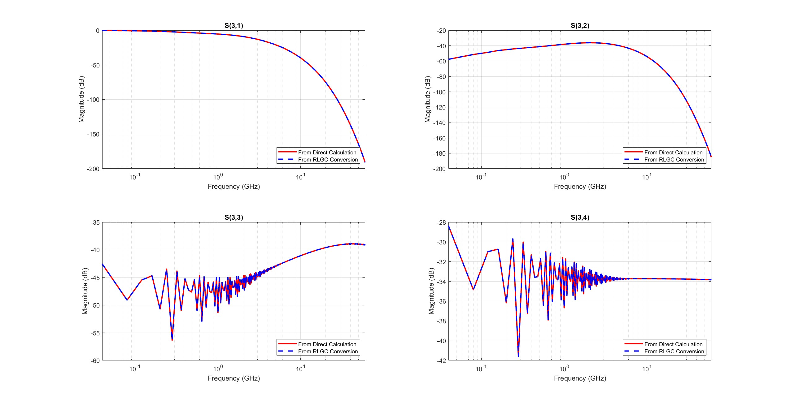
Verification of the Function by Differential Pair of Stripline - Results

Slide 11
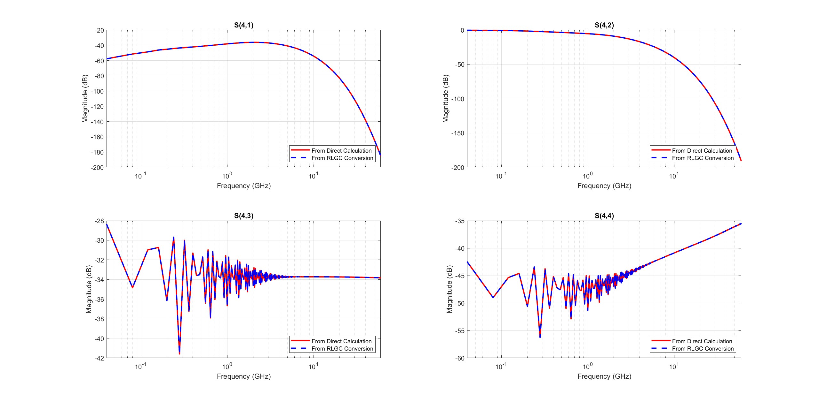
Verification of the Function by Differential Pair of Stripline - Results

Slide 12
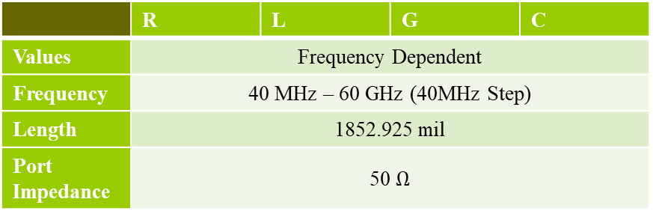
Verification of the Function by IMLC Simulations
To further verify the function, we checked and compared IMLC simulation results to rlgc2s() converted results
 | R | L | G | C
Values | Frequency Dependent
Frequency | 40 MHz – 60 GHz (40MHz Step)
Length | 1852.925 mil
Port Impedance | 50 $Ω$
Get RLGC and S parameter data from IMLC
Import RLGC parameters to Matlab
Use rlgc2s() to convert RLGC to S
Compare S parameters obtained from Matlab to S parameters obtained from IMLC Q2D

Slide 13
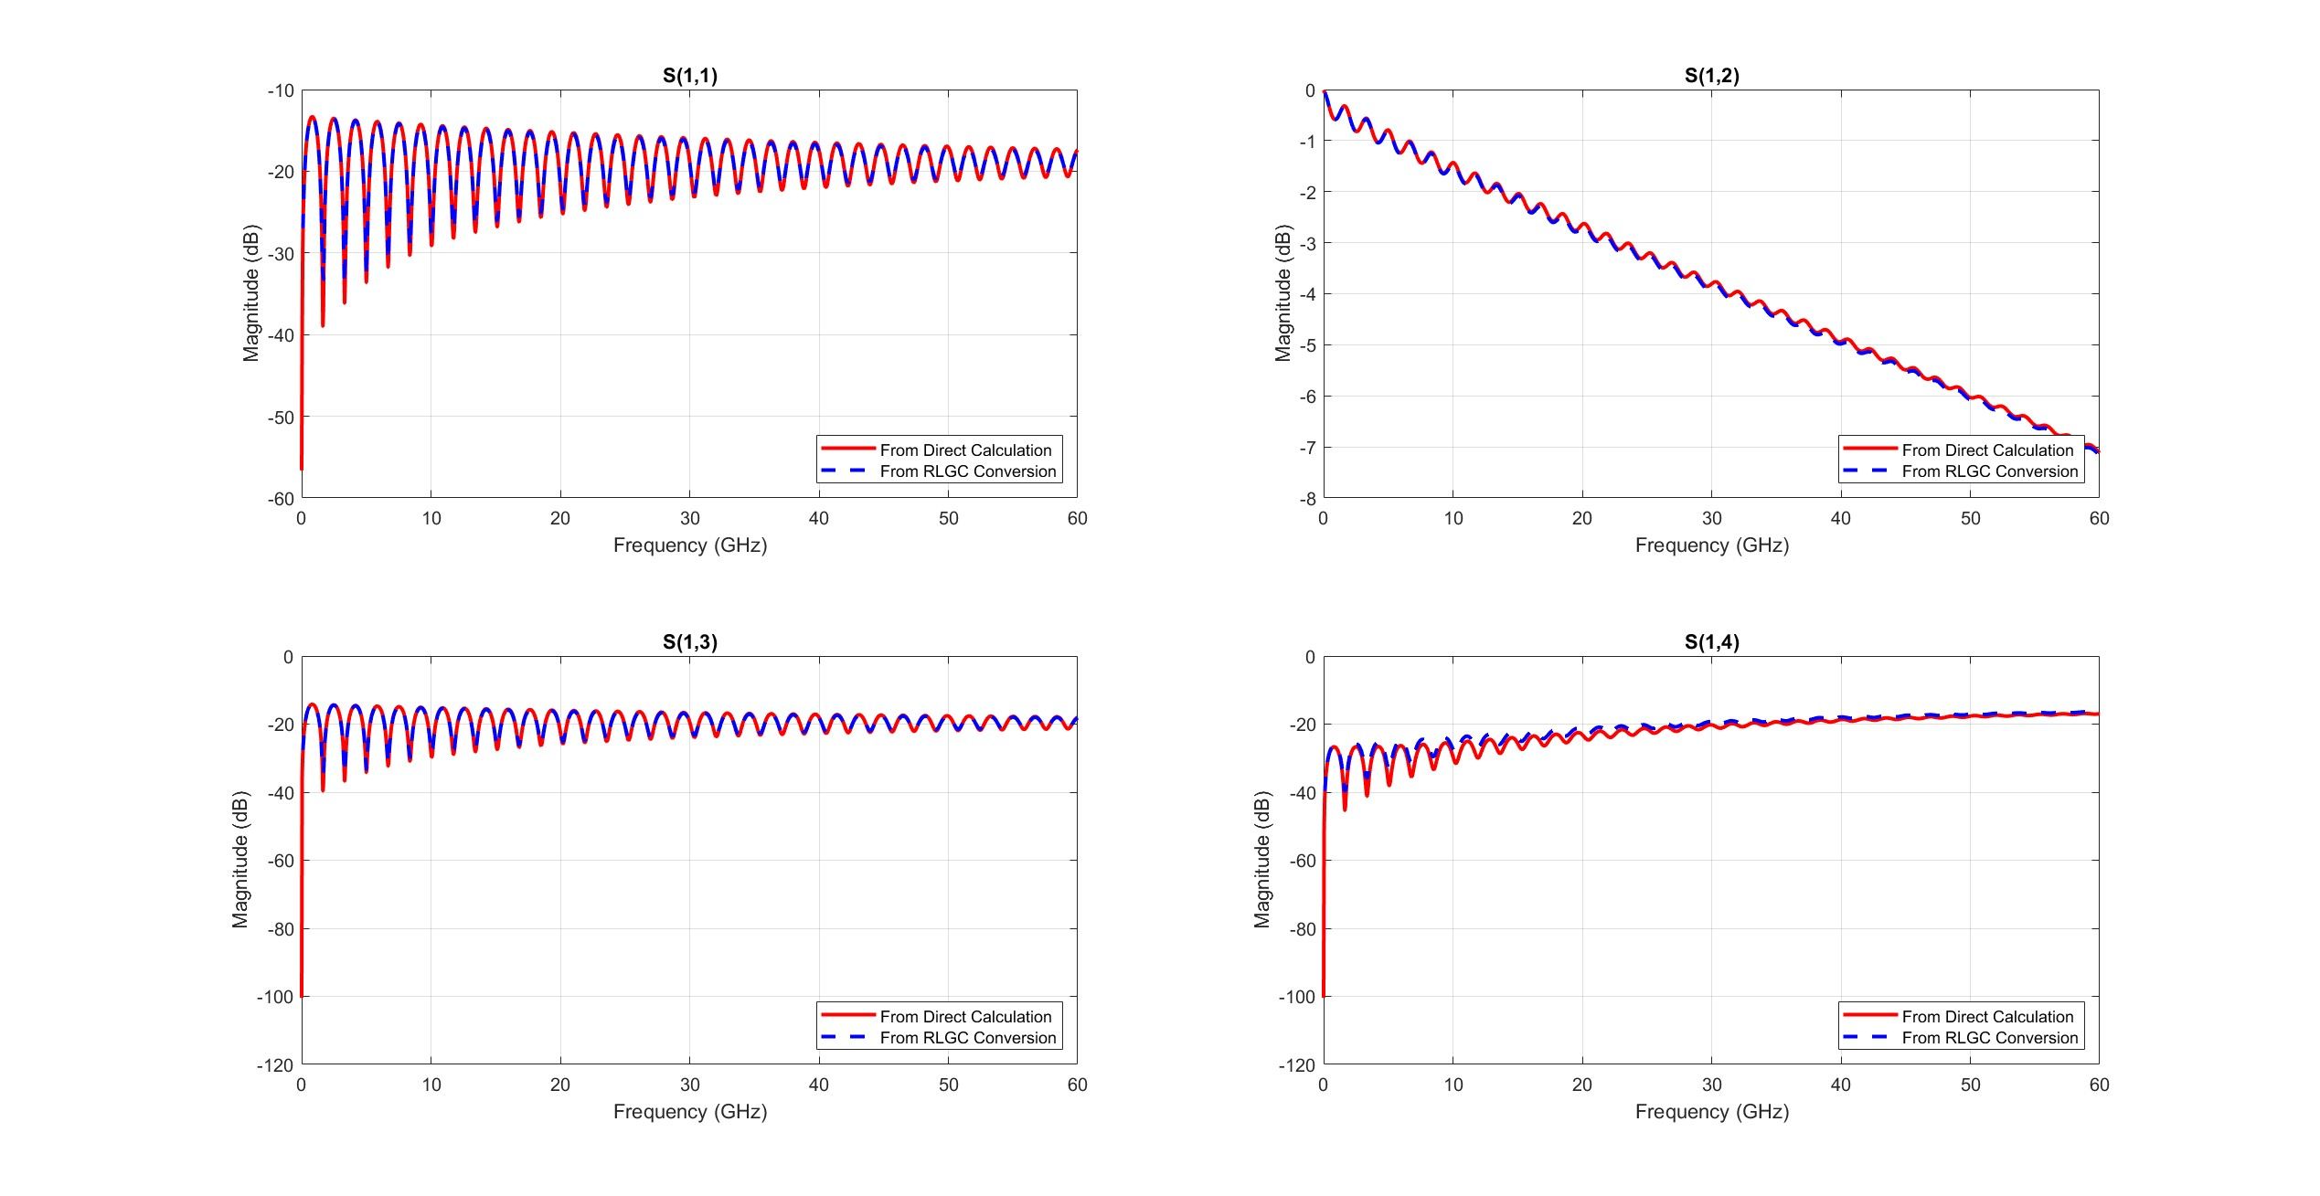
Verification of the Function by IMLC Simulations - Results

Slide 14
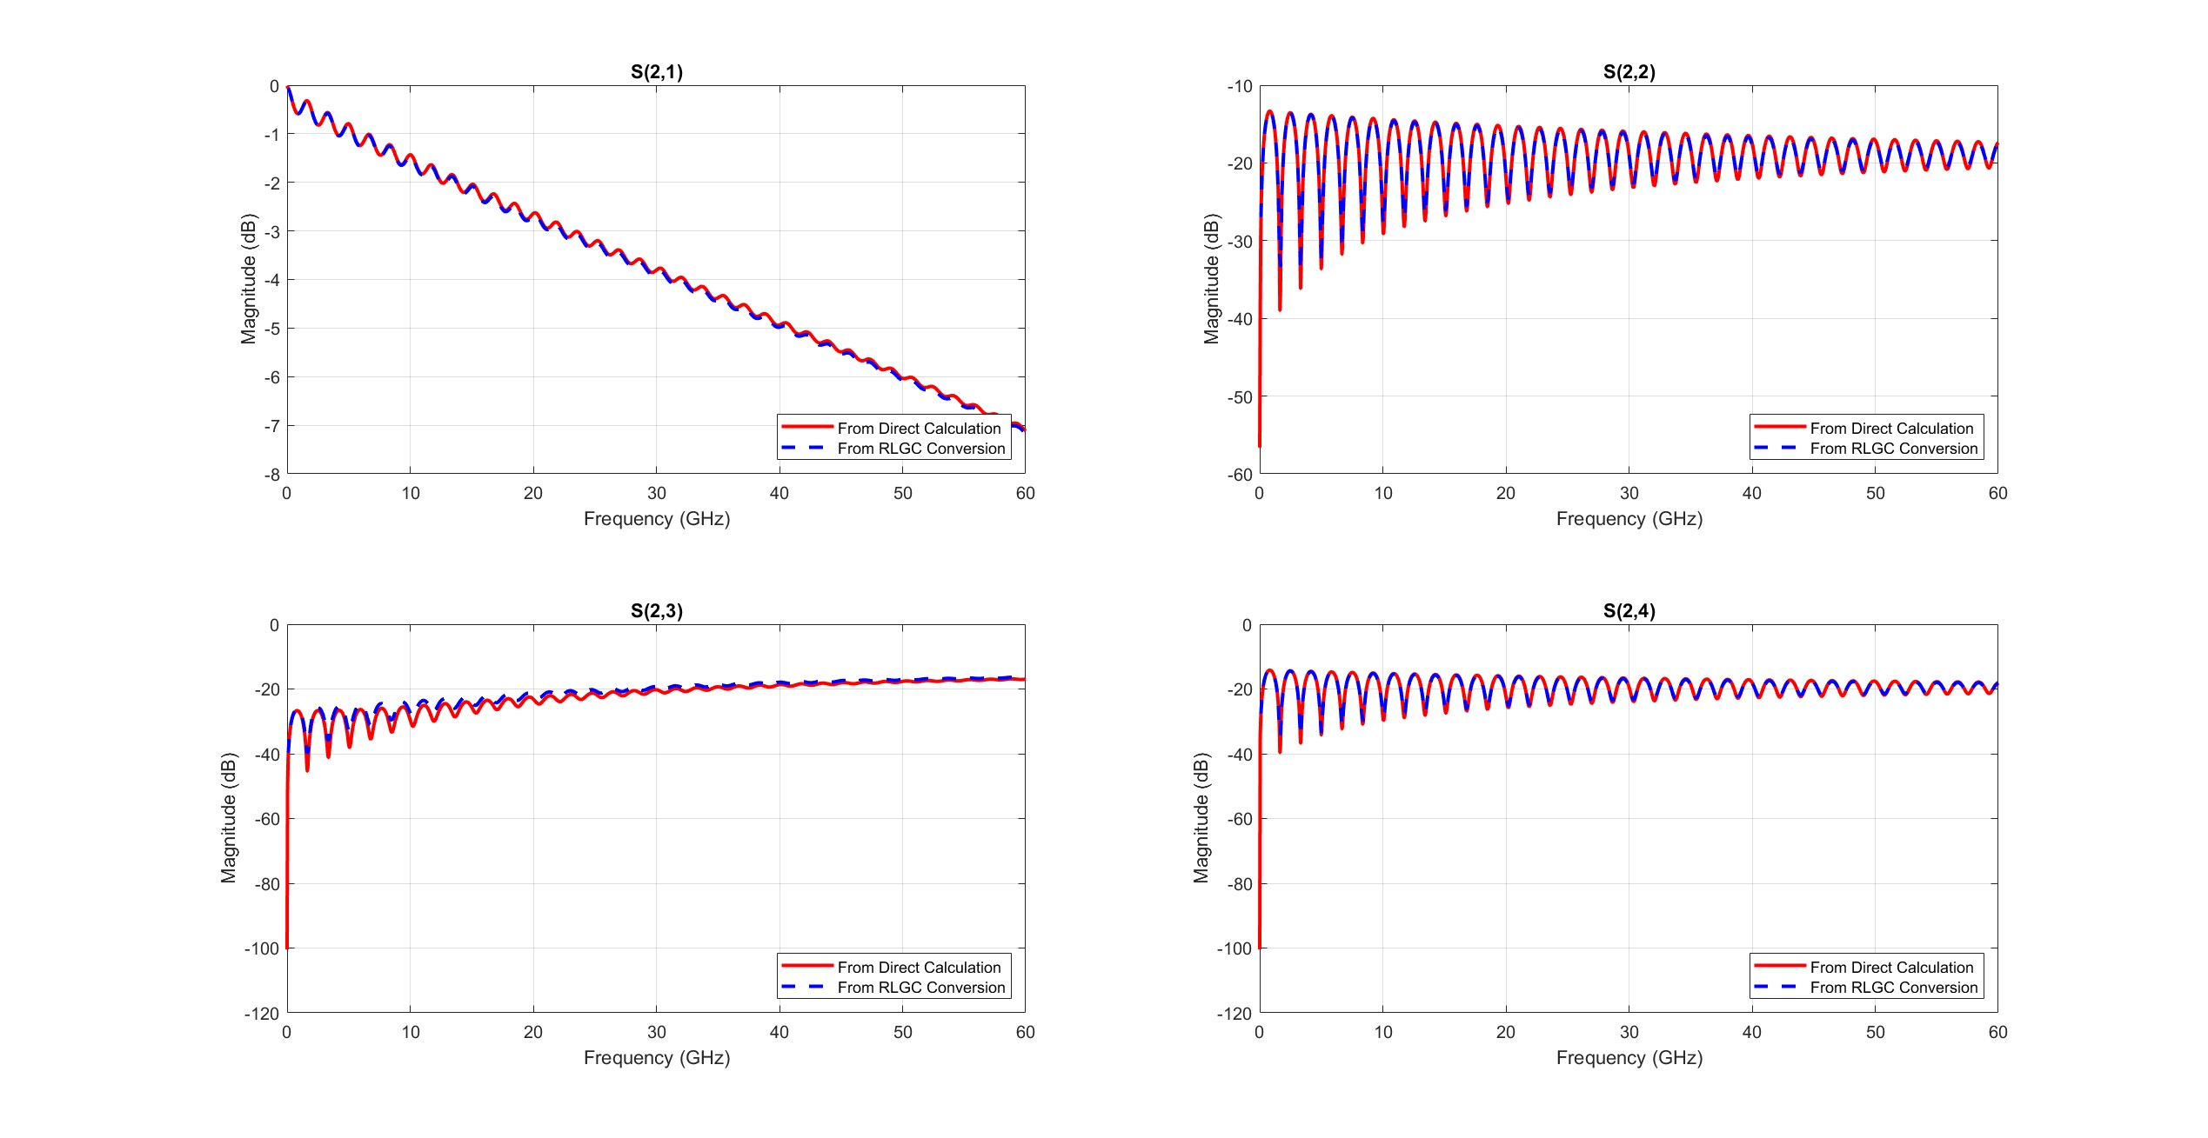
Verification of the Function by IMLC Simulations - Results

